Slide 1
From Device to Cloud – The Saga of a sensor. I2C to BLE to mbed Device Connector to IBM Watson.
Ashok Rao
Sr Applications Engineer, IoTBU
Application Engineering week, Shanghai, China.
Nov / Dec 2016

Slide 2
Aim of the project:
The aim of the project was to remotely read a sensor utilizing the various API’s mbed OS 5.2 has to offer such as I2C, BLE and mbed Client and relay the data to the cloud.
So far, all pieces – BLE..mbed client..mbed device connector were individually working by themselves as modules but an “END-TO-END” applications would demonstrate a real world application better.
Hence the necessity..

Slide 3
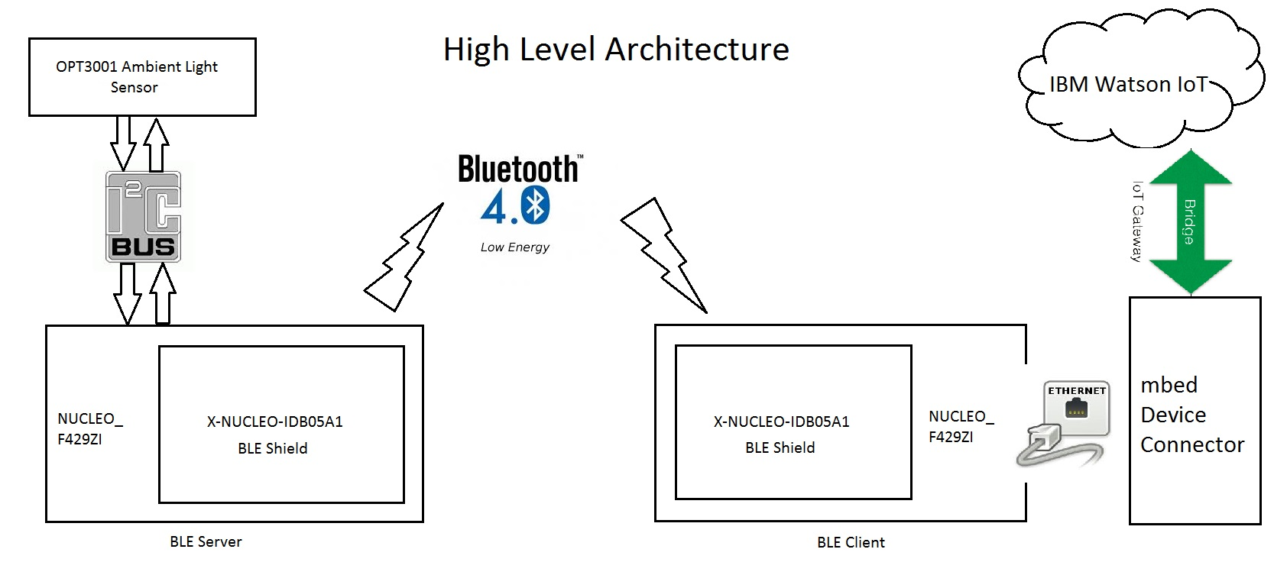
System Overview.

Slide 4
Initial Setup:
Hardware:
1. NUCLEO_F429ZI (2x) - target platform.
2. ST BLE shields (2x) – X-NUCLEO_IDB05A1.
3. OPT3001 ambient light sensor (TI’s BOOSTXL-SENSORS breakout board) (1x)
4. A few jumper wires / micro USB cables / ethernet cable.
5. An IPV4 connection to the internet.
Software:
1. mbed CLI with ARMCC and a text editor.
2. KEIL MDK (for debugging)
3. mbed Device Connector account / IBM Bluemix Free account.
4. mbed OS 5.2, latest BLE shield firmware from ST, mbed BLE libs, mbed Client libs, mbed to Bluemix bridge.
5. PuTTY / TeraTerm or your favourite serial terminal application.

Slide 5
Modules:
I2C communication for OPT3001.
Implemented as a library for re-use with other targets.
https://github.com/ashok-rao/mbed-OPT3001.git
BLE GAP Server.
Separate thread from reading sensor.
const static char DEVICE_NAME[] = "OPT3001";
ReadOnlyGattCharacteristic<float> SensorReading(CHARACTERISTIC_UUID, &lux_data, GattCharacteristic::BLE_GATT_CHAR_PROPERTIES_NOTIFY);
lux_data = read_sensor(); //From OPT3001 library
ble.updateCharacteristicValue(SensorReading.getValueHandle(), (uint8_t *)&lux_data, sizeof(float));
https://github.com/ashok-rao/BLE_Server_MY_OPT3001.git

Slide 6
Modules Contd..
BLE GATT client.
static DiscoveredCharacteristic optCharacteristic;
static const char PEER_NAME[] = "OPT3001";
const GattReadCallbackParams *response;
payload_length = response --> len;
dataforClient[i] = response --> data[i];
final_dataforClient = ((uint32_t)dataforClient[3]<<24) | (dataforClient[2]<<16) | (dataforClient[1] << 8) | (dataforClient[0]);
printf("Final data for cleint = %x\r\n", final_dataforClient);
optCharacteristic.read();
https://github.com/ashok-rao/BLE_Client_My_OPT3001.git (BLE Client only)

Slide 7
Modules Contd..
mbed client.
Separate thread from BLE client.
Re-using mbed client OoB example with modifications to send data received from BLE.
char buffer[20];
int size = sprintf(buffer,"%x",final_dataforClient);
res->set_value((uint8_t*)buffer, size);
Sensor read every 1 second, updates sent to device connector every 5 seconds. Can be modified as required.
https://github.com/ashok-rao/BLEClient_mbedDevConn_Watson.git
mbed device connector.
mbed account used to generate security.h and login credentials.
API keys for Watson.

Slide 8
Modules Contd..
Watson IoT Bridge (Thanks Doug!).
Followed Doug’s workshop slides to use bridge to connect mbed device connector to IBM Watson. In summary, the steps are:
Create Bluemix account.
Create Watson instance.
Generate API key for an app that will connect devices to Watson instance.
Create a Node-RED app to receive data with the key generated above.
Generate API key from mbed device connector to authorize Watson instance – this is done with the help of the “bridge”. Configure the bridge to use the MBED_DOMAIN and the API key for your credentials. Configure Node-RED app with these keys from both sides.
Bluemix.
Used a 30-day free account to create service, Watson IoT instance, API keys, Node-RED application.

Slide 9
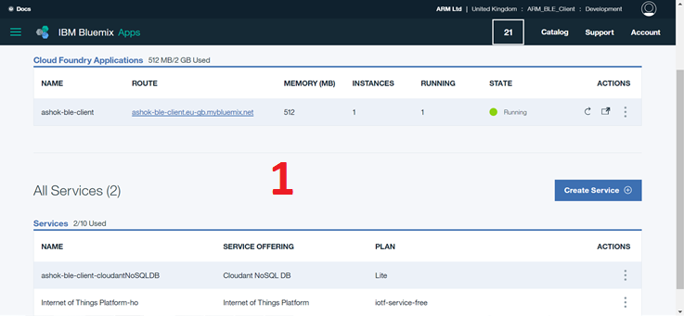
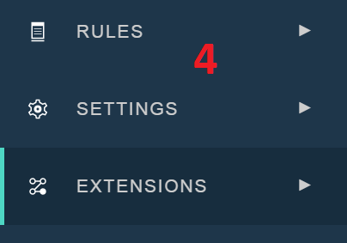
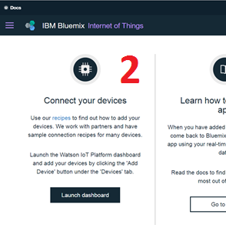
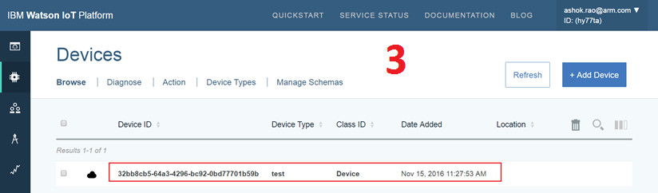

Slide 10
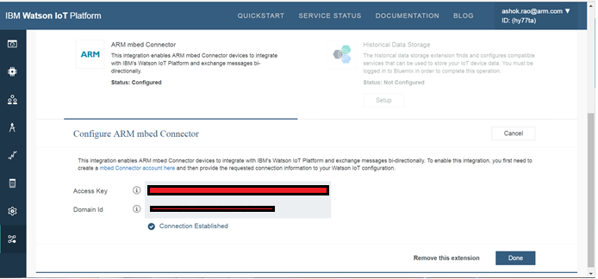
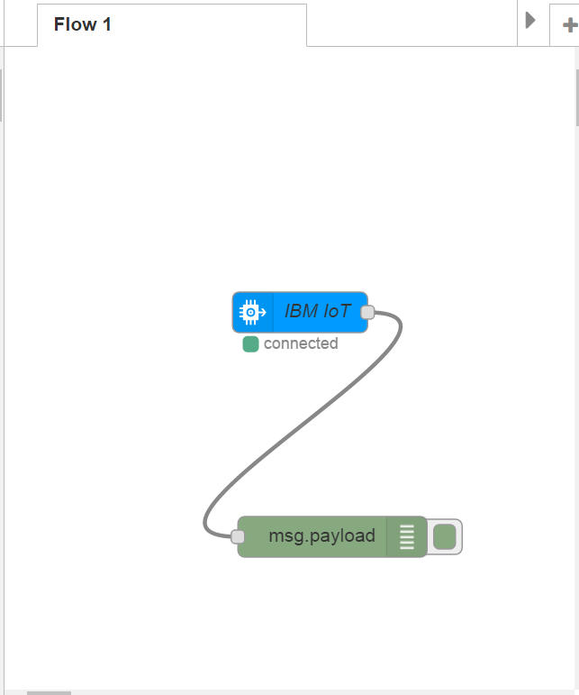
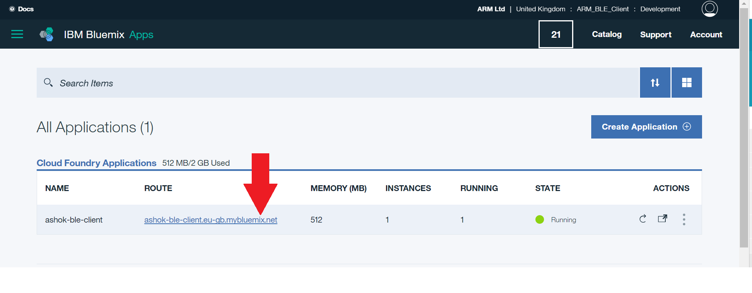
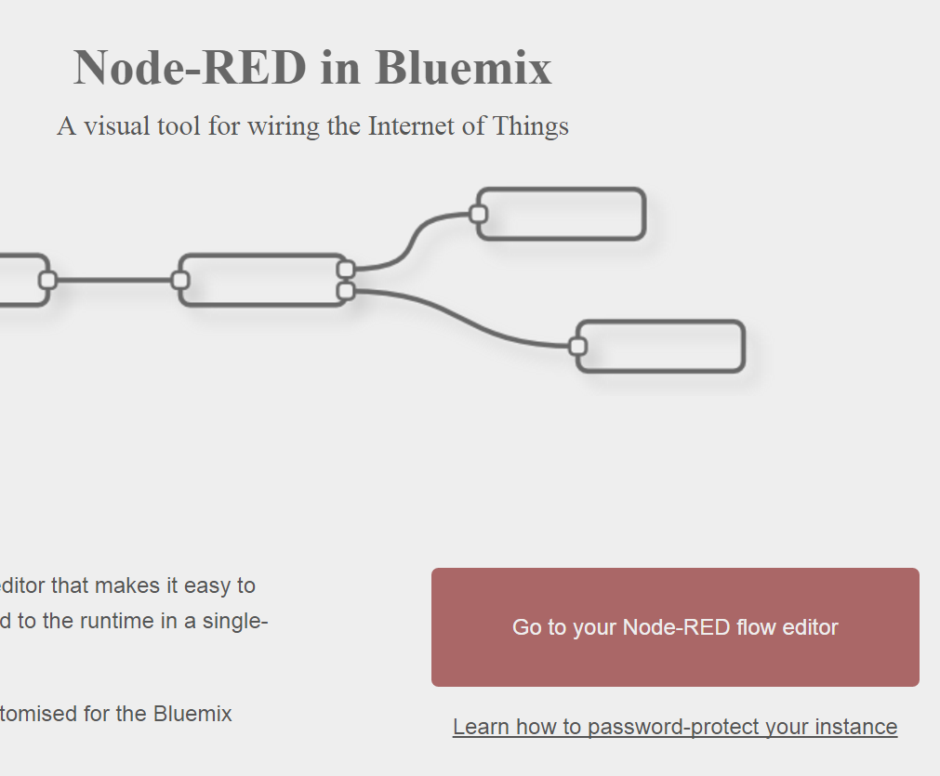

Slide 11
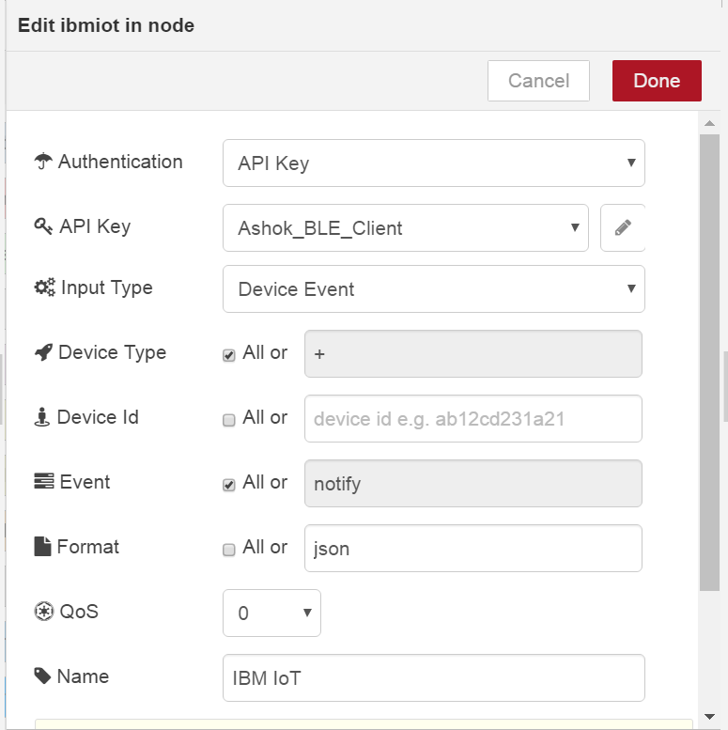
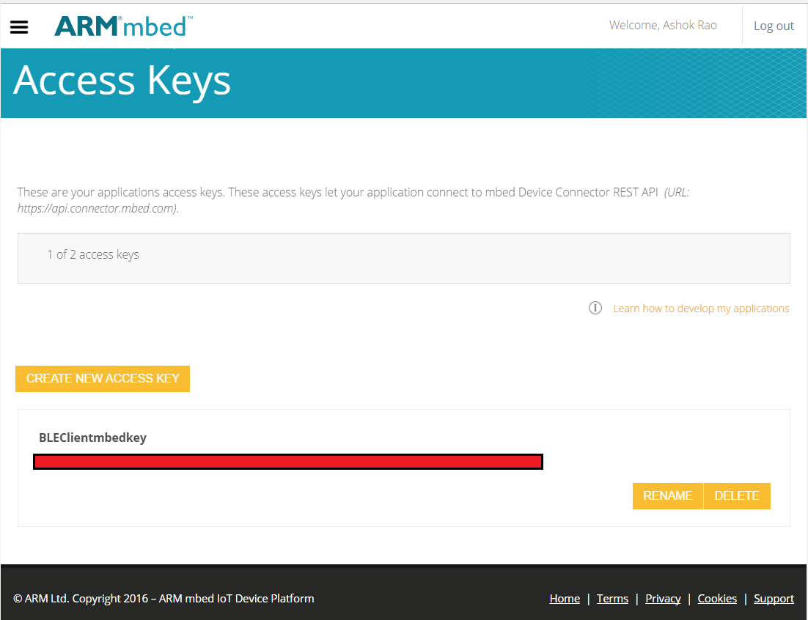
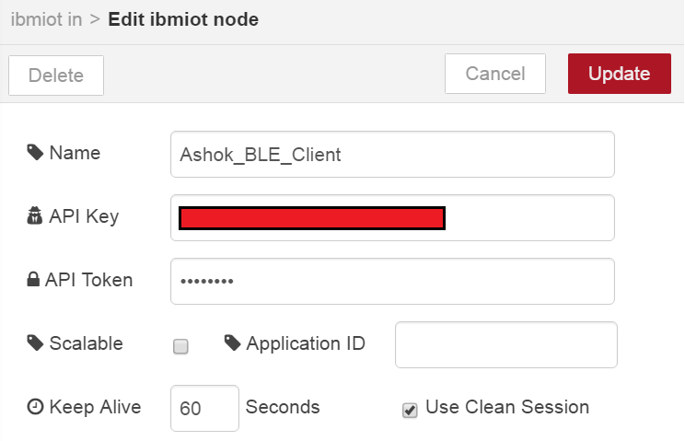

Slide 12
OK..enough theory..time for some proof..!!

Slide 13
Scope for improvements.
Currently the project is one-way. Need to implement bi-directional communication from Watson to device – turn ON a light bulb if it gets too dark.
Use mbed Cloud instead of mbed device connector.
Use this as a reference application for partners / developers.
Create a blog / article
Any other ideas from the audience ??

Slide 14
Questions / Comments??
Thank you
For contacts, find me on OrgChart ☺

